Slide 1
Data Visualization of Bird Strikes (2000 – 2011)
BY CHIRAG M V

Slide 2
Introduction to Data Visualization of Bird Strikes (2000 – 2011)
Problem Statement: The escalating volume of vehicles and people in transportation poses safety and environmental concerns. Bird strikes, particularly with aircraft, present significant risks, demanding innovative solutions.
Objectives: This project visually depicts FAA(Federal Aviation Administration) data on bird strikes (2000-2011), examining frequency, geographic patterns, airline encounters, costs, and impact on flight operations.

Slide 3
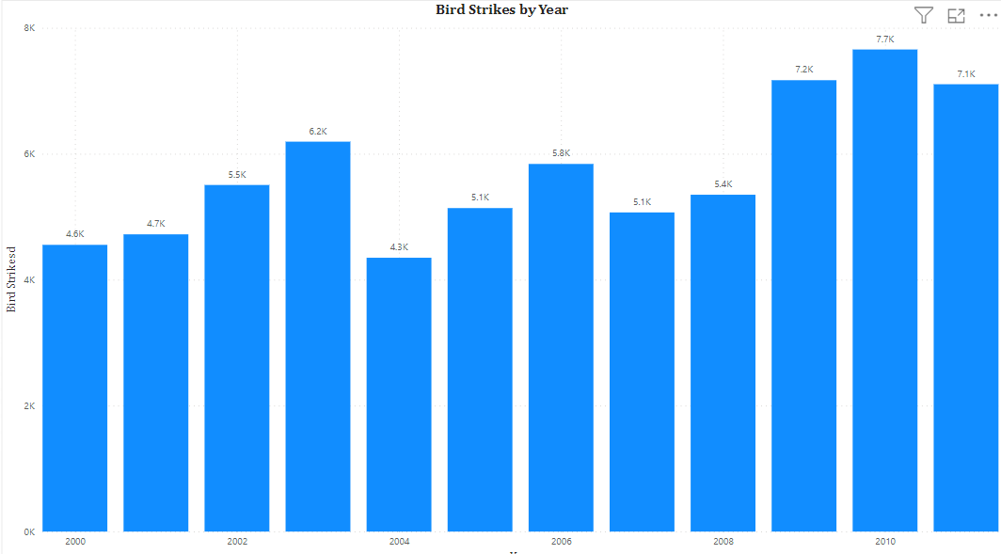
Visuals depicting number of bird strikes and yearly analysis & Bird strikes in US

Slide 4
Explanation
Increase in air traffic: One possible reason for the overall increasing trend in bird strikes could be the increase in air traffic over the years. More planes in the sky mean a higher likelihood of encountering birds.
Improved reporting: Another factor to consider is the improvement in reporting mechanisms and awareness about bird strikes. As reporting becomes more standardized and widespread, the number of reported incidents could increase, even if the actual frequency of bird strikes remains relatively constant.
Environmental factors: Changes in environmental conditions, such as climate change or alterations in bird migration patterns, could also impact the frequency of bird strikes. For example, shifts in bird populations or habitats may increase the likelihood of interactions with aircraft.
Airport location and surroundings: The location of airports and their surrounding environments can significantly influence the frequency of bird strikes. Airports near bodies of water or in close proximity to wildlife habitats may experience higher rates of bird strikes.
Mitigation efforts: Efforts to mitigate bird strike risks, such as implementing bird control measures around airports or developing technologies to detect and deter birds, may have varying levels of effectiveness over time, leading to fluctuations in the number of incidents.
Regulatory changes: Changes in aviation regulations or policies related to wildlife management near airports could also impact the frequency of bird strikes.

Slide 5
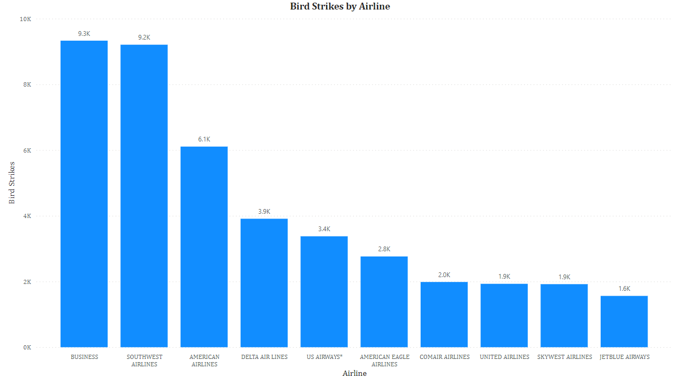
Top 10 US Airlines in terms of having encountered bird strikes

Slide 6
Explanation
Flight volume: Airlines with higher flight volumes are likely to encounter more bird strikes simply due to increased exposure to birds during flight. Airlines such as BUSINESS and SOUTHWEST AIRLINES, which may have larger fleets or operate more flights, might consequently have higher numbers of bird strikes.
Routes and locations: Airlines operating in regions with higher bird populations or in areas with significant wildlife habitats, such as wetlands or coastal regions, may experience more bird strikes. The geographical distribution of flight routes and hubs could influence the frequency of bird strike incidents.
Aircraft type: Certain aircraft models may be more susceptible to bird strikes than others due to factors such as engine design, size, or flight altitude. Airlines with fleets primarily composed of aircraft known to be more prone to bird strikes might experience higher numbers of incidents.
Airport proximity to wildlife: Airlines operating out of airports located near bodies of water, farmland, or natural habitats may face increased risks of bird strikes. Airports with extensive wildlife management programs and bird control measures may be better equipped to mitigate these risks.
Safety protocols and training: Differences in safety protocols, crew training, and wildlife hazard management practices among airlines can also impact the likelihood and severity of bird strike incidents. Airlines with robust safety programs and proactive measures to prevent bird strikes may experience fewer incidents.
Reporting practices: Variations in reporting practices and procedures among airlines could influence the accuracy and consistency of bird strike data. Airlines with more comprehensive reporting systems or stricter reporting requirements may appear to have higher numbers of bird strikes.

Slide 7
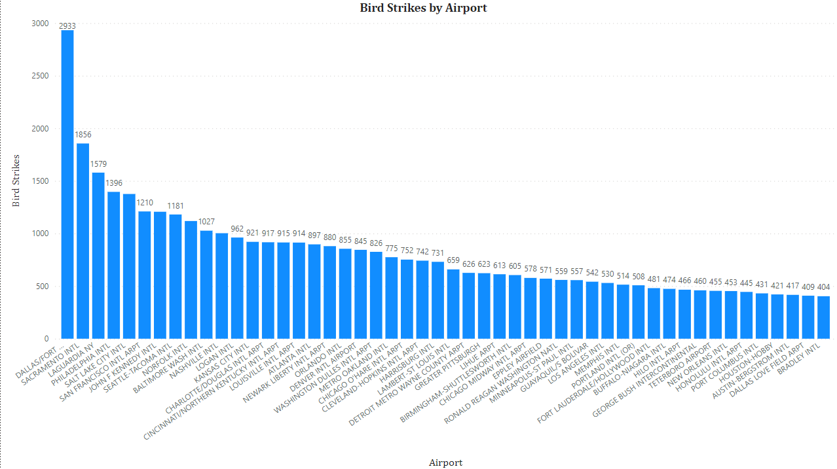
Airports with most incidents of bird strikes – Top 50

Slide 8
Explanation
Dallas/Fort Worth International Airport (DFW), Texas: DFW Airport has experienced bird strike incidents due to its location in the Dallas-Fort Worth metropolitan area and proximity to various lakes and wetlands.
Sacramento International Airport (SMF), California: Sacramento International Airport is located in Northern California. While not among the airports with the highest reported bird strike incidents nationwide, it still faces risks due to its proximity to agricultural areas and wetlands along the Sacramento and American Rivers.
LaGuardia Airport (LGA), New York: LaGuardia Airport is situated in New York City, surrounded by water bodies and wetlands. It has historically experienced numerous bird strike incidents due to its location near Jamaica Bay Wildlife Refuge and the East River.
Philadelphia International Airport (PHL), Pennsylvania: Philadelphia International Airport is located near the Delaware River and other water bodies, making it susceptible to bird strike incidents. Additionally, the airport is situated in an area with diverse bird populations, including migratory species.
Salt Lake City International Airport (SLC), Utah: Salt Lake City International Airport is surrounded by the Great Salt Lake and nearby wetlands, posing bird strike risks. While it may not have as many incidents as some coastal airports, it still experiences bird strikes, particularly during migration seasons.
San Francisco International Airport (SFO), California: SFO is situated near the San Francisco Bay and Pacific Coast, making it prone to bird strikes from seabirds and other coastal species. The airport has reported notable bird strike incidents, necessitating active bird management strategies.

Slide 9
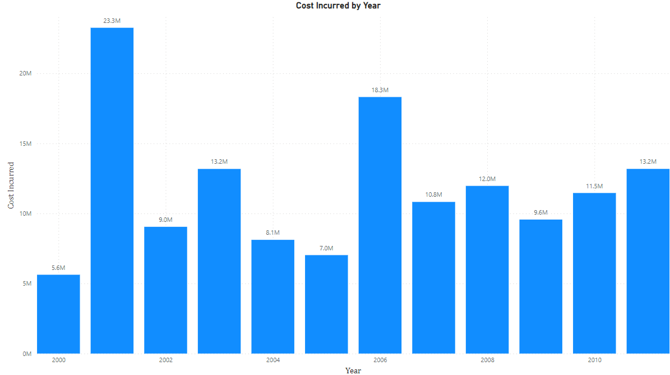
Yearly Cost Incurred due to Bird Strikes

Slide 10
Explanation
2000: The relatively lower cost in this year could be attributed to various factors such as effective bird control measures in place, favorable environmental conditions that year, or possibly lower air traffic volume compared to subsequent years.
2001: The significant increase in costs in 2001 could be due to a variety of factors, including increased air traffic post-9/11 as well as heightened awareness and reporting of bird strike incidents following the tragic events of September 11, 2001. Airlines and airports might have invested more resources in bird strike prevention and mitigation measures after the terrorist attacks.
2002-2005: Fluctuations during these years might be influenced by changes in environmental factors, variations in air traffic volume, and the effectiveness of bird control measures implemented by airports and airlines.
2006: The spike in costs in 2006 could be due to a surge in bird strike incidents caused by changes in bird migration patterns, increased air traffic, or potentially the ineffectiveness of existing bird control measures.
2007-2009: Costs appear to decrease during these years, possibly indicating improved bird strike prevention and mitigation efforts, favorable environmental conditions, or decreased air traffic volume due to economic downturns such as the global financial crisis of 2008.
2010-2011: The increase in costs during these years might be attributed to factors such as rising air traffic volume, changes in bird migration patterns, or the need for additional investments in bird strike prevention measures due to evolving regulatory requirements or technological advancements.

Slide 11
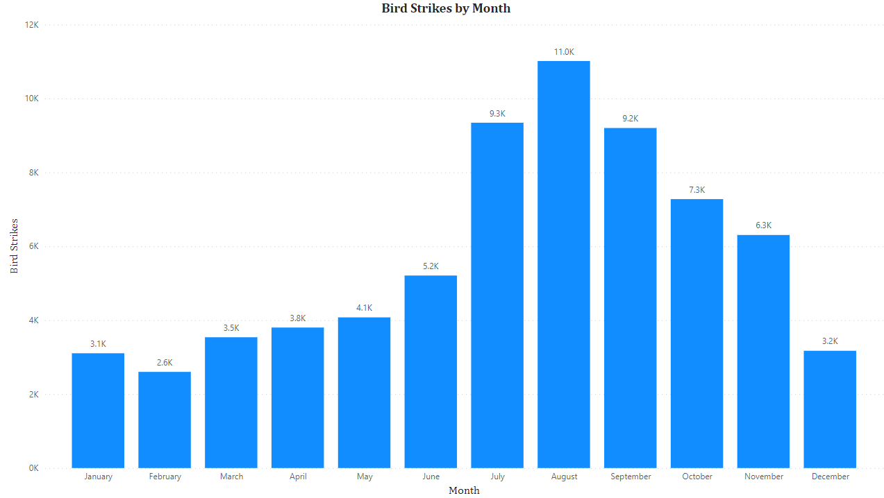
Frequency of most Bird Strikes

Slide 12
Explanation
January (3.1k): January may see a relatively lower number of bird strikes compared to other months due to factors such as colder weather in many regions, which could lead to reduced bird activity and migration. Additionally, the post-holiday season may result in fewer flights and thus fewer opportunities for bird strikes.
February (2.6k): Similar to January, February may also experience lower bird strike numbers due to continued cold weather and reduced bird activity. However, as some migratory species begin to return to their breeding grounds, there could be a slight increase in bird strike incidents compared to January.
March (3.5k): March typically marks the beginning of spring in many regions, leading to increased bird activity and migration as temperatures start to rise. This uptick in bird movement could contribute to a higher number of bird strikes compared to the previous months.
April (3.8k): As spring progresses, April sees further increases in bird activity and migration, particularly as more species begin their breeding season. This could result in a continued rise in bird strike incidents compared to earlier months.
May (4.1k): May is often a peak month for bird strikes as many migratory birds reach their breeding grounds and bird populations increase. Warmer weather and longer daylight hours also encourage more bird activity, leading to a higher likelihood of encounters with aircraft.
June (5.2k): Bird strike incidents typically continue to rise in June as breeding activity peaks for many bird species. Increased bird numbers and activity, along with higher air traffic volumes associated with summer travel, contribute to the elevated number of incidents.
July (9.3k): July may see a significant spike in bird strikes due to peak breeding activity and the highest levels of bird populations during the summer months. Increased air traffic associated with summer vacations further heightens the risk of bird strikes.
August (11k): August often represents the peak of bird strike incidents, driven by continued high bird populations and activity levels. Migration may also begin for some species, leading to additional encounters with aircraft.
September (9.2k): While still relatively high, bird strike numbers may begin to decrease in September as some migratory species start their southward journeys. However, breeding activity remains high for others, maintaining the risk of bird strikes.
October (7.3k): Bird strike incidents may continue to decline in October as more migratory birds depart, reducing overall bird populations and activity levels compared to the summer months.
November (6.3k): As winter approaches, bird strike numbers may decrease further as more migratory birds have left the area, resulting in lower bird populations overall.
December (3.2k): December typically sees a decrease in bird strike incidents as winter weather sets in, leading to reduced bird activity and migration. Lower air traffic associated with the holiday season may also contribute to fewer encounters between birds and aircraft.

Slide 13
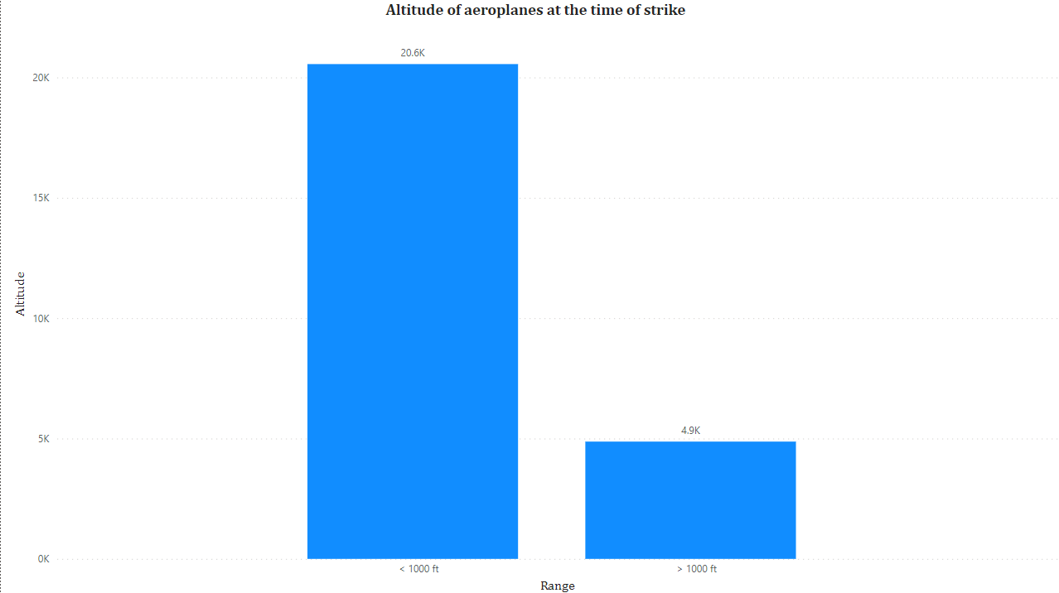
Altitude of Aeroplanes at the time of the strike

Slide 14
Explanation
The disparity in altitude at the time of the bird strike—20.6 thousand incidents occurring at altitudes below 1000 feet and 4.9 thousand incidents above 1000 feet—can be explained by several factors:
Takeoff and Landing: Aircraft are typically at lower altitudes during takeoff and landing phases of flight, which are critical stages where bird strikes are more likely to occur. Birds often inhabit areas near airports, and as aircraft ascend or descend, they pass through these bird-rich environments, increasing the likelihood of strikes.
Flight Patterns: Aircraft may fly at lower altitudes during certain phases of flight, such as during approach and departure from airports or during low-altitude flight over terrain. These flight patterns can intersect with bird habitats, leading to a higher incidence of bird strikes at lower altitudes.
Airport Proximity: Bird activity tends to be higher near airports due to the presence of food sources, water bodies, and green spaces. Birds may congregate in these areas, increasing the risk of strikes for aircraft operating at lower altitudes, particularly during takeoff and landing.
Climbing and Descending: During climb and descent phases, aircraft are transitioning between altitudes, passing through airspace where birds may be present. While climbing, aircraft may encounter birds flying at similar altitudes, especially in areas with concentrated bird activity. Similarly, during descent, aircraft descending towards airports may encounter birds as they descend into lower altitudes.
Cruising Altitude: Aircraft typically fly at higher altitudes during the cruising phase of flight, which reduces the likelihood of encountering birds. However, bird strikes can still occur at cruising altitudes, particularly for birds capable of flying at high altitudes or during rare instances of bird migration at high altitudes.

Slide 15
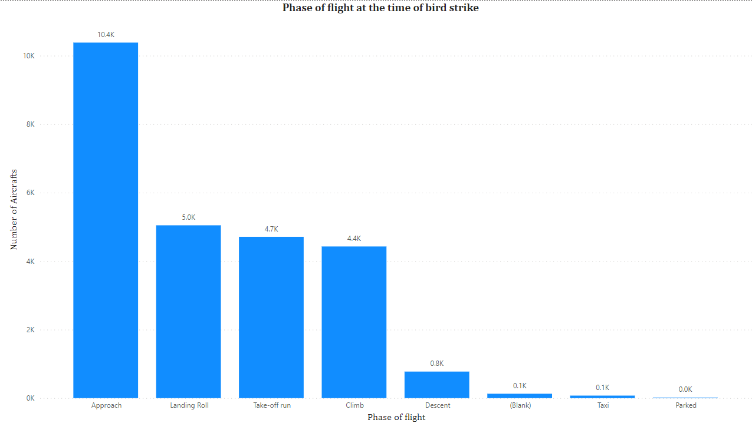
Phase of flight at the time of the strike

Slide 16
Explanation
Approach (10.4k): The approach phase involves the final segment of flight before landing, during which aircraft descend towards the airport runway. Bird strikes are common during this phase as aircraft fly at relatively low altitudes and are closer to airports where bird activity is often concentrated.
Landing roll (5k): Bird strikes can also occur during the landing roll, which is the phase immediately after touchdown when the aircraft is decelerating on the runway. Birds may be startled by the noise and presence of landing aircraft, leading to strikes as they attempt to avoid the aircraft.
Take-off run (4.7k): During the take-off run, aircraft are accelerating down the runway to achieve takeoff speed. Bird strikes can occur during this phase as aircraft pass through bird-rich environments near airports or encounter birds flying at low altitudes.
Climb (4.4k): Bird strikes may occur during the climb phase as aircraft ascend to their cruising altitude. Birds may be present in the airspace surrounding airports or along flight paths, especially in areas with high bird populations or migratory routes.
Descent (0.8k): The descent phase involves aircraft descending towards the destination airport. Bird strikes during descent are less common compared to other phases of flight, but they can still occur, particularly in areas with bird activity near airports or along approach paths.
Taxi (0.1k): Bird strikes can occur during taxiing, especially if airports are located in areas with high bird populations or if birds are attracted to airport facilities such as runways, taxiways, or terminal areas.
Parked (0k): While aircraft are parked on the ground, bird strikes are unlikely since the aircraft is stationary and not in motion. However, birds may still pose a nuisance or safety hazard to parked aircraft if they roost or nest in close proximity to airport facilities.
Blank (0.1k): The "Blank" category may represent instances where the phase of flight at the time of the strike was not specified or recorded.

Slide 17
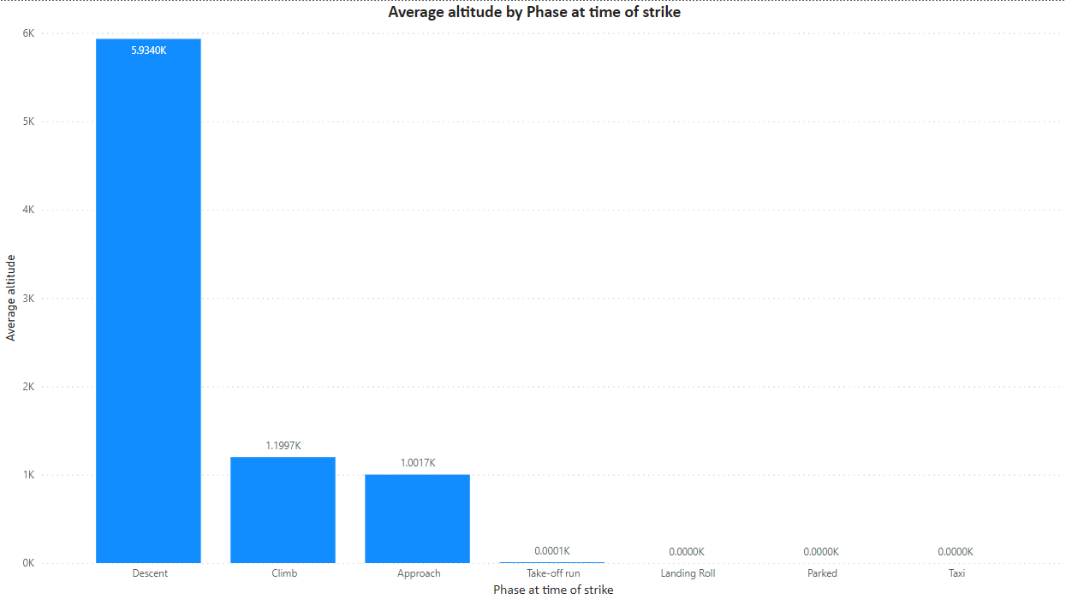
Average Altitude of the aeroplanes in different phases at the time of strike

Slide 18
Explanation
Descent (5.9k): During the descent phase, aircraft are typically descending from their cruising altitude to prepare for landing. The average altitude of 5.9k feet suggests that bird strikes during descent often occur at higher altitudes, possibly as aircraft are descending through airspace where birds may be flying or during approaches to airports.
Climb (1.2k): Aircraft are ascending during the climb phase to reach their cruising altitude. The relatively lower average altitude of 1.2k feet during climb indicates that bird strikes in this phase generally occur at lower altitudes, possibly as aircraft ascend through airspace where bird activity is more common, such as near airports or along flight paths.
Approach (1k): The approach phase involves the final descent towards the runway before landing. The average altitude of 1k feet suggests that bird strikes during approach typically occur at lower altitudes, as aircraft are closer to the airport environment where bird activity is concentrated.
Take-off run (1): The take-off run phase occurs as aircraft accelerate down the runway to achieve takeoff speed. The average altitude of 1 foot indicates that bird strikes during takeoff runs occur very close to the ground, likely as aircraft are beginning their ascent and encountering birds near the airport environment.
Landing roll (0): The landing roll phase occurs immediately after touchdown, as aircraft decelerate on the runway. The average altitude of 0 feet suggests that bird strikes during the landing roll occur on or very close to the ground, likely as aircraft are taxiing on the runway or as they come to a stop after landing.
Parked (0): Aircraft on the ground while parked are at ground level, resulting in an average altitude of 0 feet. Bird strikes while aircraft are parked are uncommon but may occur if birds perch or roost near parked aircraft.
Taxi (0): During taxiing, aircraft move on the ground between runways, taxiways, and gates. The average altitude of 0 feet indicates that bird strikes during taxiing occur at ground level, likely as aircraft are moving on the airport surface.

Slide 19
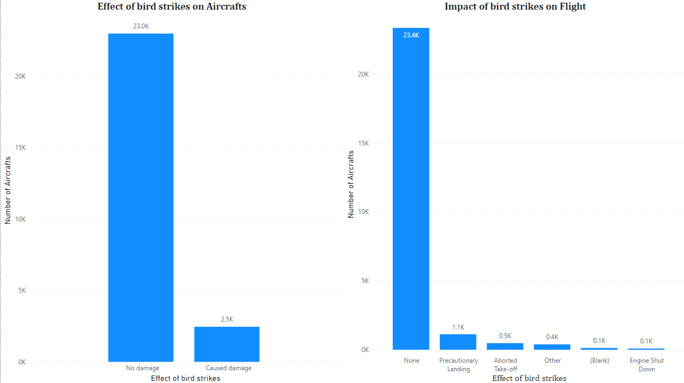
Effect of Bird Strikes & Impact on Flight

Slide 20
Explanation
Effect of Bird Strikes on Aircraft:
No Damage (23k): The majority of bird strikes, approximately 92% in this dataset, result in no damage to the aircraft. This could occur when the aircraft strikes a bird without causing significant impact or when the aircraft's design and construction can withstand the force of the strike without sustaining damage.
Caused Damage (2.5k): Approximately 8% of bird strikes result in damage to the aircraft. This damage can vary in severity, ranging from minor cosmetic damage to critical structural damage affecting the aircraft's airworthiness and safety.
Impact of Bird Strikes on Flight:
None (23.4k): The majority of bird strike incidents, corresponding to approximately 93.6% of cases, do not have any significant impact on the flight. In these instances, the aircraft can continue its flight without any need for special precautions or emergency procedures.
Precautionary Landing (1.1k): In some cases, pilots may opt for a precautionary landing following a bird strike, especially if they suspect or observe damage to the aircraft, such as engine performance issues or structural damage. This precautionary measure ensures that the aircraft can be inspected and any necessary repairs can be conducted before continuing the flight.
Aborted Take-off (0.5k): Bird strikes occurring during takeoff can lead to an aborted takeoff, where the aircraft's takeoff roll is halted before it becomes airborne. This precautionary measure allows the flight crew to assess the situation, inspect the aircraft for damage, and take appropriate action to ensure the safety of the flight.
Other (0.4k): This category may include various impacts of bird strikes on flight operations that do not fit into the predefined categories, such as minor delays, diversions to alternate airports, or changes in flight routing.
Blank (0.1k): Instances where the impact of the bird strike on flight operations was not specified or recorded.
Engine Shut Down (0.1k): In rare cases, bird strikes can cause significant damage to aircraft engines, leading to engine performance issues or failures. As a safety precaution, pilots may opt to shut down the affected engine(s) and execute emergency procedures to safely land the aircraft.

Slide 21
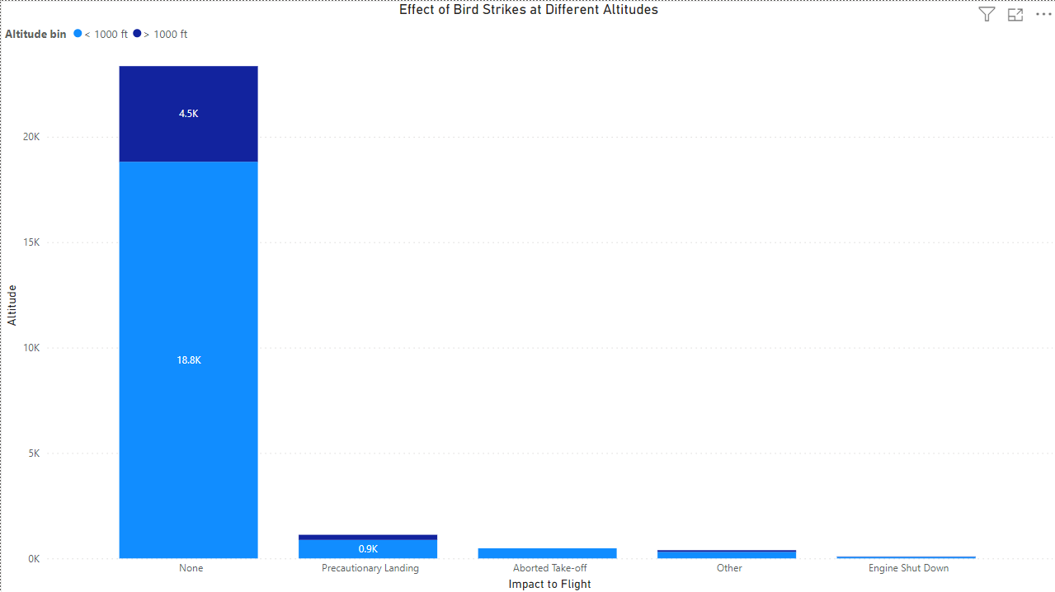
Effect of Strike at Different Altitude

Slide 22
Explanation
None (18.8k): The majority of bird strike incidents, representing approximately 82.6% of cases in this dataset, do not result in any significant impact on flight operations. Despite encountering a bird, these incidents do not necessitate any immediate action or precautionary measures, allowing the flight to continue without interruption.
Precautionary Landing (0.9k): In a small percentage of cases, approximately 3.9% of incidents, pilots may opt for a precautionary landing following a bird strike. This decision is made if there are concerns about potential damage to the aircraft or if the flight crew deems it necessary to inspect the aircraft before continuing the flight. Precautionary landings ensure the safety of passengers and crew by allowing for a thorough assessment of the aircraft's condition.
Aborted Take-off (0.45k): Bird strikes occurring during the take-off phase may result in an aborted take-off, where the aircraft's take-off roll is halted before becoming airborne. This precautionary measure, accounting for approximately 2% of incidents, allows the flight crew to evaluate the situation, inspect the aircraft for damage, and take appropriate action to ensure flight safety.
Other (0.3k): This category encompasses various impacts of bird strikes on flight operations that do not fit into the predefined categories of precautionary landing or aborted take-off. Examples may include minor delays, diversions to alternate airports, or changes in flight routing due to bird strike incidents.
Engine Shut Down (0.1k): In rare instances, approximately 0.4% of cases, bird strikes can cause significant damage to aircraft engines, leading to engine performance issues or failures. As a safety precaution, pilots may decide to shut down the affected engine(s) and execute emergency procedures to safely land the aircraft.

Slide 23
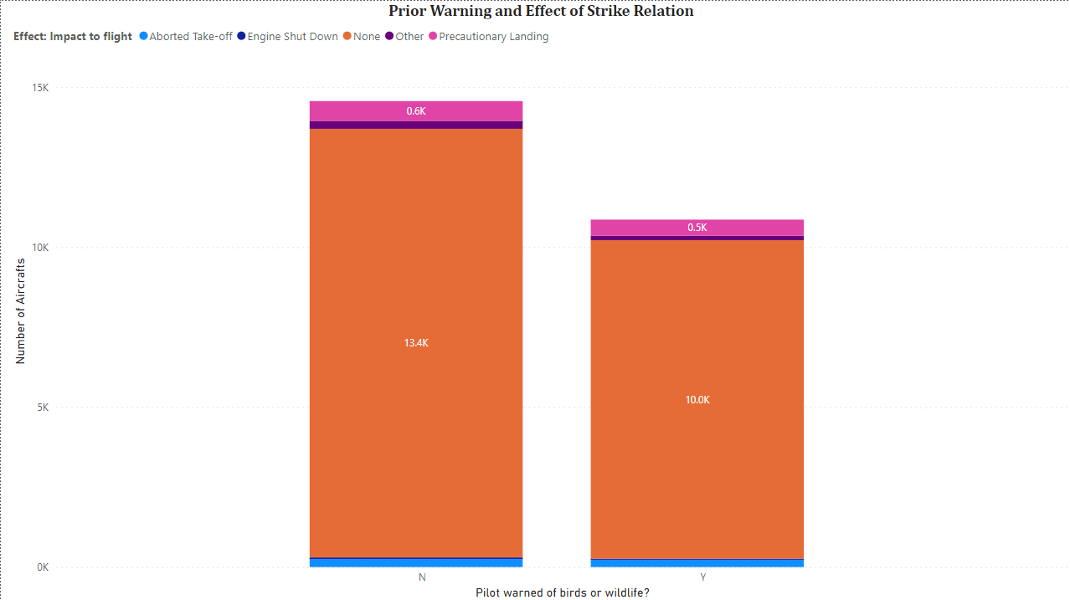
Prior Warning for Pilots and Effect of Strike Relation

Slide 24
Explanation
Pilot Warned of Wildlife:
Yes: In approximately 57.3% of bird strike incidents, pilots were alerted to the presence of wildlife, including birds, prior to the strike. These warnings could come from various sources such as air traffic control, onboard wildlife detection systems, or visual sightings by the flight crew. Pilot awareness of wildlife presence allows for heightened vigilance and may prompt pilots to take preemptive measures to avoid potential bird strike hazards.
No: In approximately 42.7% of bird strike incidents, pilots were not alerted to the presence of wildlife before the strike occurred. This could indicate scenarios where bird activity was not detected or reported in advance, leaving pilots unaware of potential hazards until the strike event.
Effect of Pilot Warning on Bird Strike Relation:
Without specific data on the effects of bird strikes in relation to pilot warnings, it's challenging to draw direct conclusions from this dataset. However, the presence or absence of pilot warnings may influence the pilots' ability to anticipate, react to, and mitigate the effects of bird strikes on flight operations.
Pilots who are warned of wildlife presence prior to a bird strike may have an opportunity to prepare for potential encounters, such as adjusting flight paths, increasing vigilance during critical phases of flight, or initiating avoidance maneuvers if feasible. This proactive approach could potentially minimize the impact of bird strikes on flight operations and enhance aviation safety.
Conversely, bird strikes occurring without prior warnings may catch pilots off guard, limiting their ability to take preemptive measures. In such cases, pilots may need to rely on their training and experience to respond effectively to the bird strike event and mitigate its impact on flight safety.

Slide 25
Thank You

